Slide 1
RSO BUDGETING BASICS

Slide 2
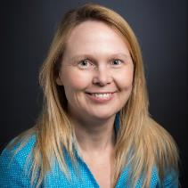
INTRODUCTION
Margo Thoresen
Business Manager,
Student Involvement

Slide 3
OVERVIEW
Registered Student Organization (RSO) FUNDING
Common Misconception
Self-Generated Revenue (SGR) vs. Student Funding Board (SFB) Allocations
Registered Student Organization (RSO) SPENDING
Spending Basics:
Authorized Users
RSO Org Code
Spending Methods:
On-Campus Charging
Purchase Order
Reimbursement
Approved Vendors
JV Transfer

Slide 4
RSO FUNDING
Notes:
How will your RSO pay for its activities?

Slide 5
Common Misconception
Complete Registration Process
Notes:
Let’s begin with a common misconception. Some students mistakenly believe that completing the process to become an RSO automatically gives them money to pay for their activities. Unfortunately, this is not the case. RSO budgets start out with a zero balance. Unless your RSO raised money the previous fiscal year and deposited that money into its account at the Cashier’s office, your RSO account is empty.

Slide 6
RSO Funding Sources
Self-Generated Revenue (SGR)
= money raised by RSOs through
membership dues
ticket revenue
donations & sponsorships
campus competitions
fundraising
Restrictions: Money must be spent in adherence with Mason policies and procedures.
Student Funding Board (SFB)
= money allocated through
SFB application process
Restrictions: Money must be spent in adherence with Mason and SFB policies and procedures.
Notes:
However, there are two ways to obtain funding for your RSO activities. The first is to raise the money and deposit it into your RSO account as self-generated revenue, or SGR. There are various ways that your RSO may obtain SGR, including: collecting dues from its members, charging admission to its events, seeking out donations and sponsorships from on or off-campus vendors, winning campus competitions, and fundraising. Because SGR should be deposited into your Mason-assigned account, the money must be spent in adherence with Mason policies and procedures. This means: (1) all SGR must be deposited into your Mason-assigned RSO account (no off-campus or personal bank accounts should be used) with the exception of RSOs who have a national affiliate that requires an off-campus account for tax purposes. (2) RSOs may not use PayPal and Venmo (or any third party processors) to collect money. Only cash and checks are accepted. Instructions on how to make a deposit into your RSO account as well as the University’s cash-handling process can be found online via the RSO Self-Service Center.
The second way to obtain funding for your RSO activities is to apply for it from the Student Funding Board, or SFB. Your RSO’s tier level determines the amount of SFB funding that it can apply for during the academic year. To apply for SFB money, an RSO must be in good standing. This means that your RSO president and treasurer have completed all of the required trainings; and your RSO has no current debt with Student Involvement or any campus partners or off-campus vendors. Because SFB allocations are funded by the student activity fee, the money must be spent not only in adherence to Mason’s policies and procedures but also according to the policies set by the Student Funding Board. Please refer to the SFB webpage (si.gmu.edu/sfb) for more information on tier amounts, collaborative funding, travel funding limits, and instructions on the SFB application process and its deadlines.
Analogy: paying your tuition by getting a job and using your wages = SGR / applying for scholarships and grants = SFB

Slide 7
RSO SPENDING
Notes:
Now that we have reviewed the two funding sources for your RSO activities, let’s discuss how your RSO can spend its money. Please note that the instructions and forms for all of the spending methods that we are about to go over can be found online via the RSO Self-Service Center.

Slide 8
Spending Basics
RSO president & treasurer = only authorized spenders
Six-digit organization code (61xxxx) used to spend both SFB and SGR.
Spending methods include:
On-Campus Charging
Purchase Order (PO)
Reimbursement
Journal Voucher (JV) Transfer
Notes:
Let’s begin with some spending basics. First, the president and treasurer of your RSO are the only individuals authorized to approve spending from your RSO account. One of their signatures is required on all spending requests submitted to Student Involvement. Second, your RSO will be assigned a six-digit organization code (also referred to as the account number) that starts with either “610” or “611” with the last three digits being unique to your RSO. This organization code (or org code for short) will be used by your RSO to spend both its SFB funding and self-generated revenue. Additionally, your RSO will use the same spending methods for both SFB funding and SGR. In other words, there is no difference in how your RSO will spend these two funding sources. You just need to make sure you have secured the funding (either SFB or SGR) prior to committing to or paying for an expense.

Slide 9
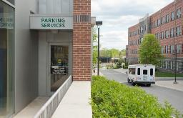
On-Campus Charging
Provide your organization code to certain on-campus offices to “charge” goods and services directly to your RSO account.
Notes:
The first spending method that we will discuss is on-campus charging. Your RSO may provide its organization code to certain on-campus offices to “charge” goods and services directly to its budget. These offices include: Parking Services, Event Services, Print Services, Mason Catering, and Police Services. By providing these offices with your RSO’s organization code, you are authorizing them to access your RSO account to deduct the final cost of the good or service that they are providing.

Slide 10
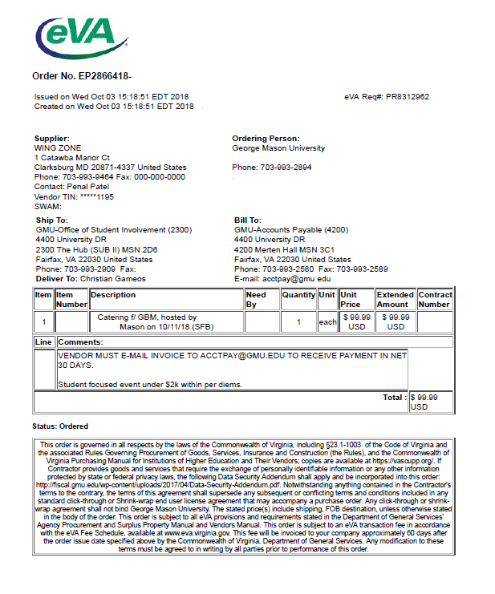
Purchase Order (PO)
Pay an off-campus vendor for a good or service.
Notes:
The second spending method available to your RSO is the purchase order (or PO). Some local vendors will accept a Mason purchase order in lieu of a cash or credit card payment at the point of sale, thus saving you from having to pay out-of-pocket for an expense. Please note that all POs must be obtained prior to the receipt of a good or service. This means that you cannot request a purchase order for an expense that has already occurred or has been received. With this in mind, we ask that all PO requests be submitted via e-mail to sibudget@gmu.edu at least 3 full business days before they are required. During busier times of the year (specifically, the months of April and May) and if the PO amount is $2000 or more, your PO request needs to be submitted at least 5 full business days in advance.

Slide 11
Mason Ravenclaws
Mason Ravenclaws
Notes:
EXAMPLE: The Mason Ravenclaws will be hosting the Yule Ball, catered by The Three Broomsticks pub. The RSO already applied for and received $500 in SFB funding for the catering, so they contact the vendor to ask if they accept Mason purchase orders as a form of payment. They do! After working out the final menu, the RSO fills out the PO Request Form and e-mails it to sibudget@gmu.edu. Within 3 business days, the Mason Ravenclaws receive the PO and forward it to The Three Broomsticks, who after catering the event sends an invoice to Accounts Payable to receive payment in net 30 days.

Slide 12
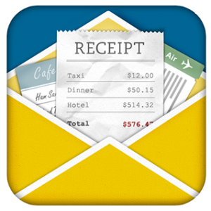
Reimbursement
Repay an RSO member for an out-of-pocket expense.
Notes:
If a vendor does not accept a Mason purchase order or your RSO does not have enough time prior to your event to request one from Student Involvement, then one of your RSO members will need to pay out-of-pocket for the expense and seek reimbursement afterwards. Please note that reimbursements may only be issued to Mason faculty, staff, or students; they must include original receipts (no copies allowed); and, they must be submitted to the front desk of Student Involvement within forty-five days of the purchase date. Since Virginia sales tax is not a reimbursable expense, please have the payee e-mail sibudget@gmu.edu to obtain a copy of the University’s tax-exempt certificate, which should be printed out and provided to the cashier upon checkout.

Slide 13
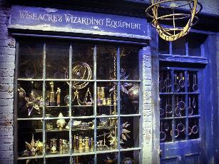
Notes:
EXAMPLE: For the Triwizard Tournament, the Mason Ravenclaws need to purchase a Goblet of Fire; however, the vendor who sells this magical object doesn’t accept purchase orders. Luna Lovegood, therefore, has decided to pay for the goblet out-of-pocket and seek reimbursement afterwards. Before she travels to Wiseacre’s Wizarding Equipment in Diagon Alley to purchase the item, she e-mails sibudget@gmu.edu to obtain a copy of the school’s tax-exempt certificate, which she will show the cashier upon check-out. After she has purchased the goblet, she fills out the RSO Payment Request Form and submits it along with the original itemized receipt, which clearly shows how she paid for the goblet. Within a month of when she submitted her reimbursement request, she receives a check from the school for the money owed to her.

Slide 14
Approved Vendors
University-approved vendors must be used for:
T-shirt Screen Printing
Embroidered Items
Promotional Items
Printed Materials
GMU Trademarked Items
Catering
Mason Ravenclaws
Mason Ravenclaws
Notes:
The University has awarded contracts to certain vendors for the purchase of t-shirt screen-printing, embroidery, promotional items, & printing. Regardless of the spending method (i.e., purchase order or reimbursement) used, we are required to order these types of items through a University-approved vendor. In other words, purchase orders or reimbursement requests for these types of expenses will be denied if they are not ordered or purchased from one of the University’s approved vendors. The list of approved vendors can be found on our online RSO Self-Service Center.
All items, which have the Mason trademark on them, must be purchased from a University-approved logo vendor. A complete list of approved vendors can be found at trademarks.gmu.edu. Please note that if your RSO plans to sell t-shirts or promotional items with a Mason trademark, the vendor will add an additional 20% royalty fee to the cost of your order. If, however, your RSO is simply providing these items to its members, then please let the vendor know so that you are not charged this additional fee.
To use an off-campus caterer, you must select one of the vendors on the University’s approved caterers list, located at shopmason.gmu.edu/approved-caterers-list/. The vendors on this list have met certain insurance requirements and health & safety standards.

Slide 15
Journal Voucher (JV) Transfer
Move money between university accounts.
George Mason University
Notes:
Often when collaborating on events, your RSO may find that it needs to provide funding towards or share the cost of an expense with another RSO or Mason office. When this occurs, your RSO should e-mail a journal voucher, or JV, request to sibudget@gmu.edu. A JV transfer is simply an internal movement of money between University accounts.

Slide 16
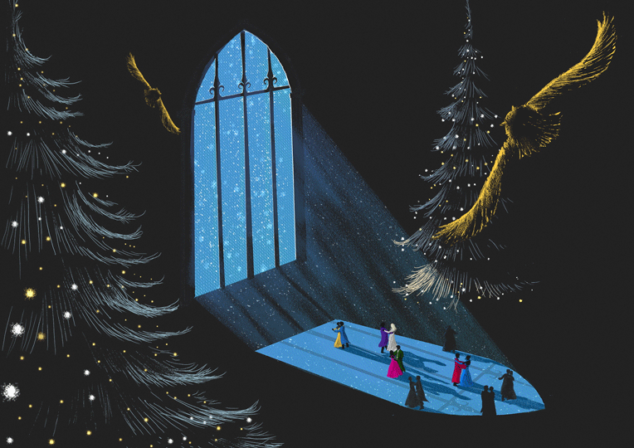
Notes:
EXAMPLE: The Ravenclaws are co-sponsoring an end-of-the-year celebration with the Gryffindor House. Although the Ravenclaws are organizing the event and, therefore, are responsible for arranging payment for the various expenses, the Gryffindors would like to share the cost of the event and have decided to contribute $200 from its self-generated revenue to the Ravenclaws. To do so, the Gryffindor House should submit a JV transfer request.

Slide 17
RSO Self-Service Center:
https://si.gmu.edu/rso-self-service-center/
RSO Forms & Resources:
https://si.gmu.edu/forms-and-resources/

Slide 18
Resources
RSO Self-Service Center:
https://si.gmu.edu/rso-self-service-center/
Answers to many RSO questions, including funding, spending, room reservations, advertising, cash handling, etc.
E-mail Addresses:
sibudget@gmu.edu → RSO spending and budget questions
sfb@gmu.edu → SFB funding requests / allocations
rso@gmu.edu → RSO registration, advisement and assistance

